Slide 1
Machine Learning for Games
1

Slide 2
Overview
Introduction
Neural Networks
Deep Learning
Reinforcement Learning
ML-Agents
References

Slide 3
Classification Data Example
class | sepal length | sepal width | petal length | peta lwidth
setosa | 5.1 | 3.5 | 1.4 | 0.2
setosa | 4.9 | 3.0 | 1.4 | 0.2
versicolor | 6.1 | 2.9 | 4.7 | 1.4
versicolor | 5.6 | 2.9 | 3.6 | 1.3
virginica | 7.6 | 3.0 | 6.6 | 2.1
virginica | 4.9 | 2.5 | 4.5 | 1.7
150 rows or examples (50 per class)*
The class or target column is usually refered as vector Y
The matrix of the rest of columns (attributes or features) is usually referred as matrix X
* Source : Iris problem UCI repository (Frank & Asunción, 2010)

Slide 4
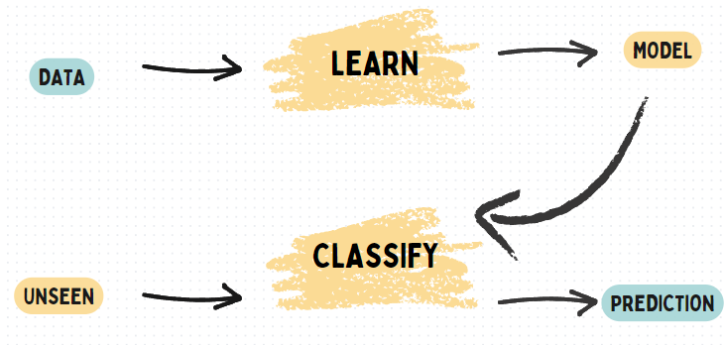
Main Objective
Build from data a model able to give a prediction to new unseen examples.
where:
data = previous table
unseen = [4.9, 3.1, 1.5, 0.1]
prediction = "setosa"

Slide 5
Regression Data Example
quality | density | pH | sulphates | alcohol
6 | 0.998 | 3.16 | 0.58 | 9.8
4 | 0.9948 | 3.51 | 0.43 | 11.4
8 | 0.9973 | 3.35 | 0.86 | 12.8
3 | 0.9994 | 3.16 | 0.63 | 8.4
7 | 0.99514 | 3.44 | 0.68 | 10.55
1599 examples & 12 columns (11 attributes + 1 target)*
The main diference between classification and regression is the Y or target values:
Classification: discrete or nominal values Example: Iris, {“setosa”, “virginica”, “versicolor”}.
Regression: continuous or real values Example: WineQuality, values from 0 to 10.

Slide 6
Example method:
kNN with k=1
How can be give a prediction to next examples?
Unseen regression example on WineQuality
Let’s begin with a representation of the problems...
class | sep-len | sep-wid | pet-len | pet-wid
?? | 4.9 | 3.1 | 1.5 | 0.1
Unseen classification example on Iris
target | density | pH | sulphates | alcohol
?? | 0.99546 | 3.29 | 0.54 | 10.1

Slide 7
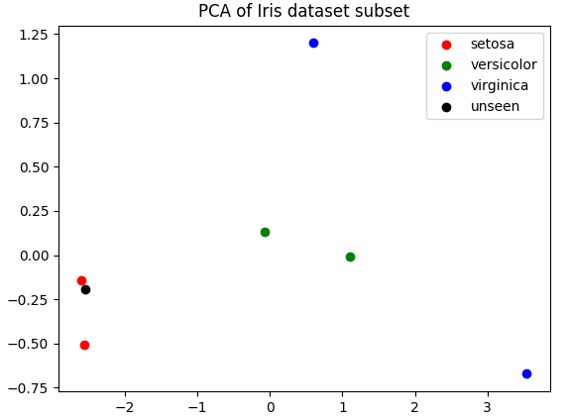
Classification Data Example

Slide 8
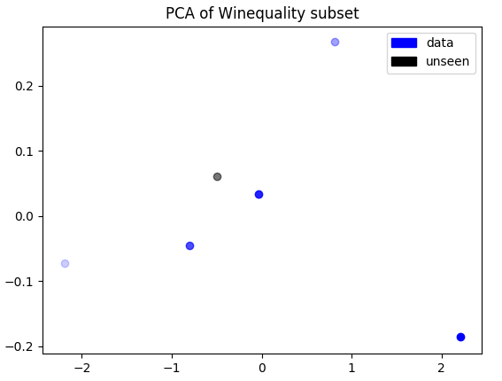
Regression Data Example

Slide 9
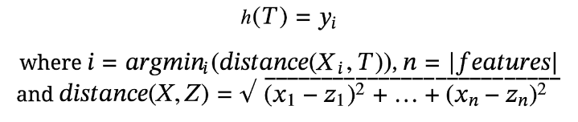
1 Nearest Neighbors algorithm
classification & regression
Classification example (Iris):
distances: [0.47, 0.17, 3.66, 2.53, 6.11, 3.45]
prediction = setosa (0.17)
Regression example (WineQuality):
distances: [0.33, 1.32, 2.72, 1.71, 0.49]
prediction = 6 (0.33)

Slide 10
How about games?
Application examples:
Classification: decision about braking a car.
Source: (Millington, 2019)
Regression: required amount of force in a curve.
Brake? | Distance | Speed
Y | 2.4 | 11.3
Y | 3.2 | 70.2
N | 75.7 | 72.7
N | 2.8 | 15.2
%? | 79.2 | 12.1

Slide 11
Decision Learning
A basic application is learning decisions from observations
decisions will become classes (𝑌)
observations will become features (𝑋)
Some kind of measure is needed to evaluate the model
The Balance of Effort
Many times is harder learning than human dessign (such as Behaviour Tree)

Slide 12
Overview
Introduction
Neural Networks
Deep Learning
Reinforcement Learning
ML-Agents
References

Slide 13
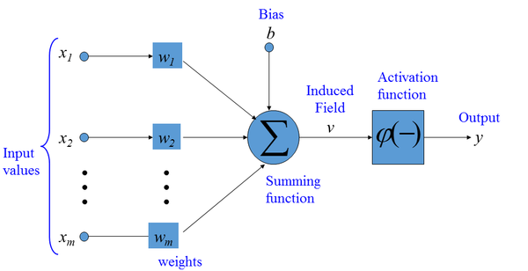

Artificial Neuron Model
Source: Artificial Neuron

Slide 14
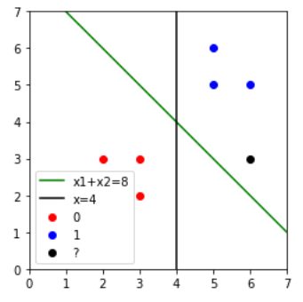
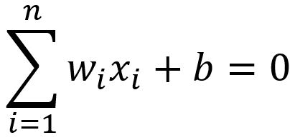
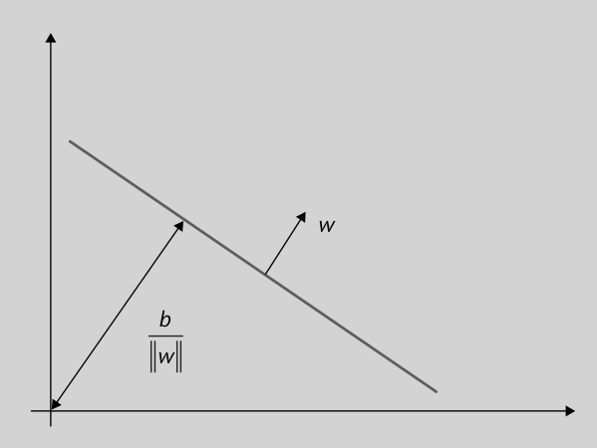
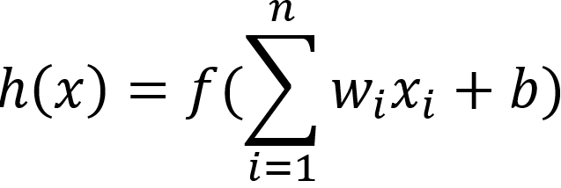
Perceptron
Classifier and regressor
One neuron (or unit)
Linear model
Model: hyperplane
Prediction formula:
In python:
view / notebook

Slide 15
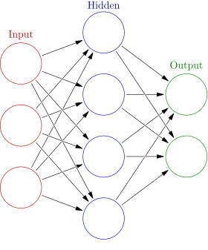
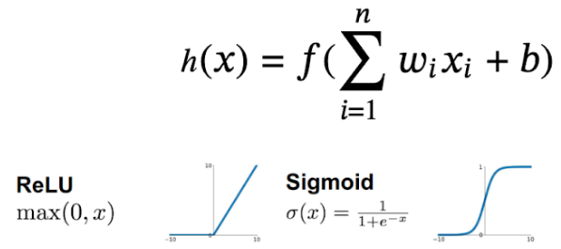
Multi - layer Perceptron
Classification & regression
One hidden layer
Non-linear model
Prediction:
Forward propagation:
source
source

Slide 16
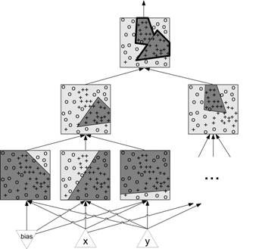
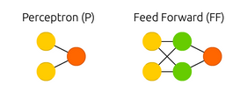
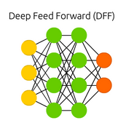
MLP Capabilities
Deep Learning:
several hidden layers
Source: (left) / (right)

Slide 17
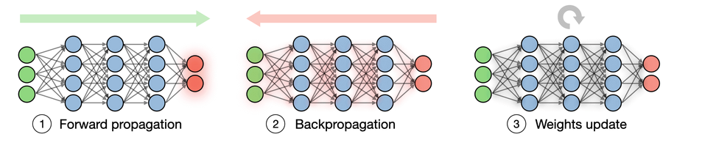
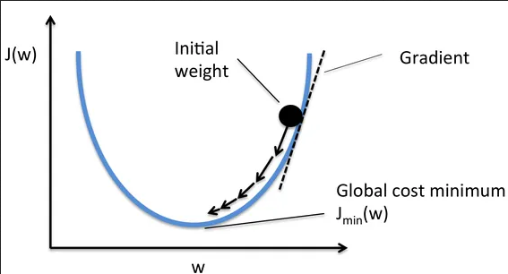
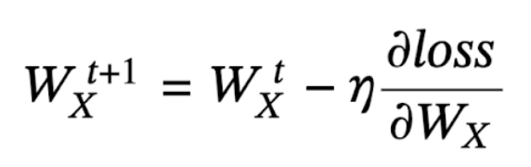
Backpropagation
Learning algorithm: determining weights and biases
Gradient descent (optimization):
loss: error(h(x), y)
n: learning rate, step size
W: weights and biases
t: iteration step
source
source

Slide 18
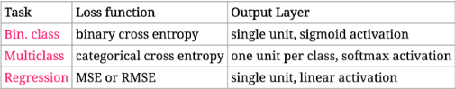
Keras (over Tensorflow)
Deep Learning high level library.
Examples:
Iris Data Set: data/description
Usual parameters:
Hidden layers & number of neurons
Epochs: times all examples are trained
Batch size: examples at each step (32, 64, 128... or training size)
Optimizer: gradient descent variants (Adam)
Activation function of hidden neurons (ReLU)
Documentation: Keras/Tensorflow/Tensorflow Playground

Slide 19
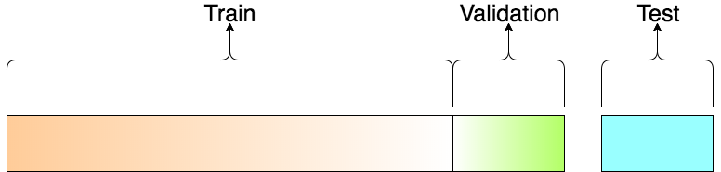
Evaluation protocol
Main objective: choose:
model,
parameters and/or
hyperparameters
Train to adjust W
Validation used on each iteration/epoch to monitor performance
source

Slide 20
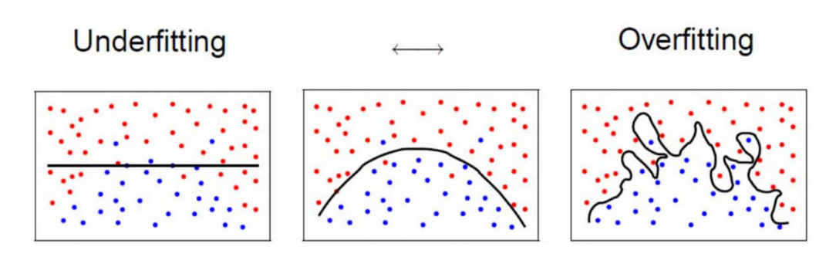
Underfitting & Overfitting
Underfitting(bias)
Symptoms:
high training error
Causes
model too simple
not enough training
Overfitting(variance)
Symptoms:
low training error
higher validation error
Causes
model too complex
too much training
training set too small

Slide 21
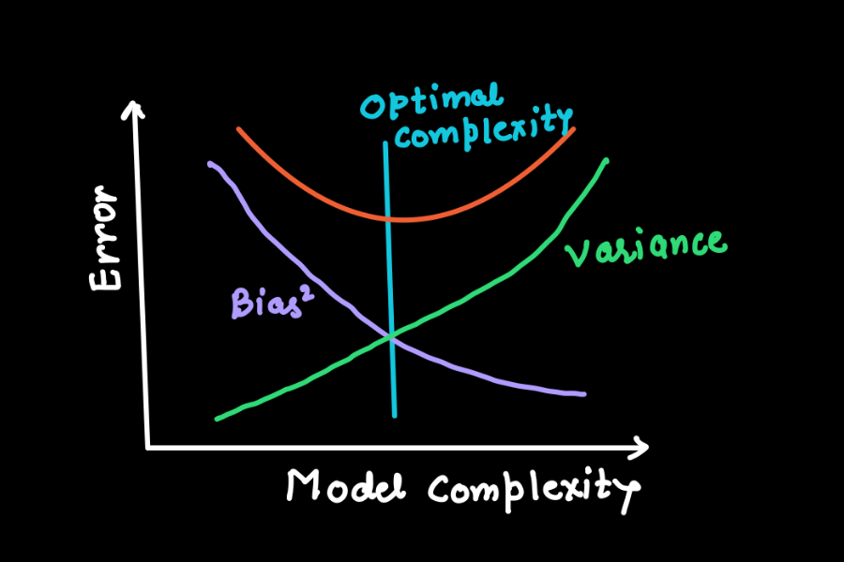
Model Complexity & Erros

Slide 22
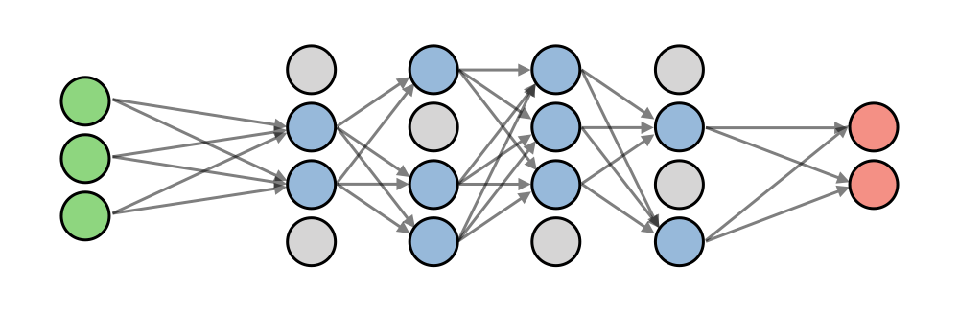
Dropout
Drop out neurons with a certain probability at each iteration
Avoid overfitting
source

Slide 23
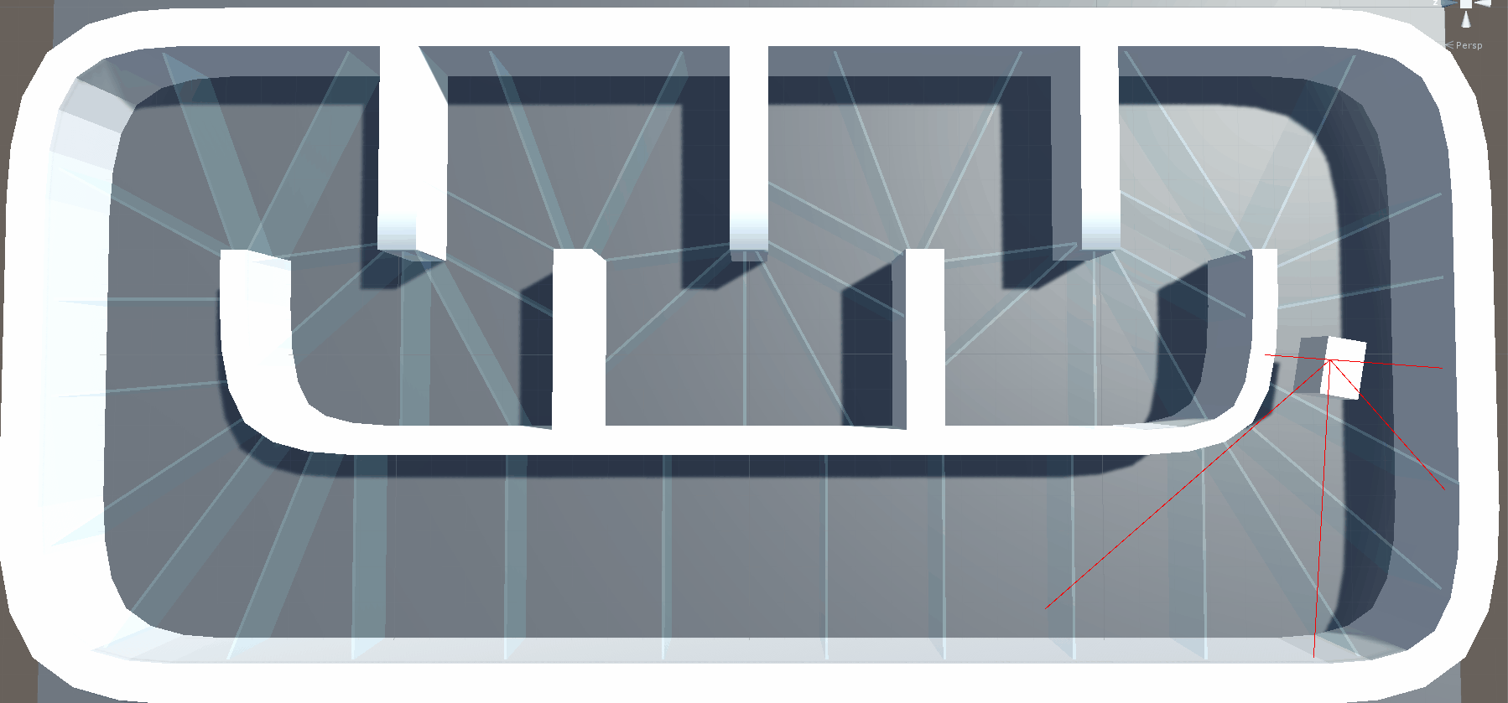
Example on Unity
Building a neural network framework in C#
BackPropNetwork
Unity Project in Github
Backpropagation implementation

Slide 24
Overview
Introduction
Neural Networks
Deep Learning
Image Classification
Time Series
Reinforcement Learning
ML-Agents
References

Slide 25
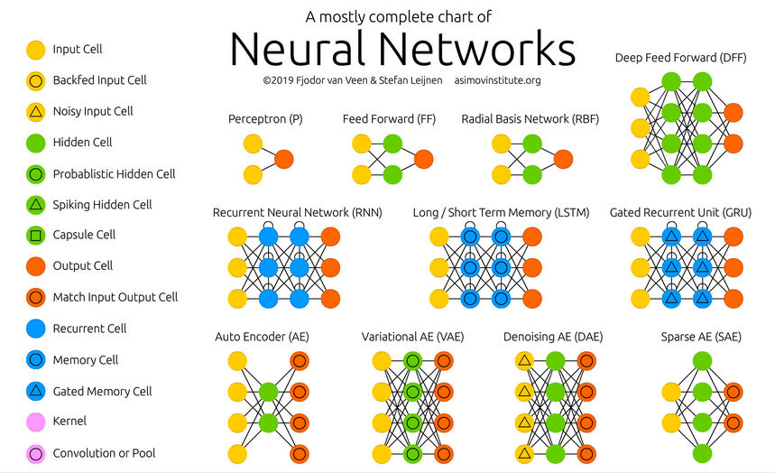
Deep Learning Architectures I
Source: The Neural Network Zoo

Slide 26
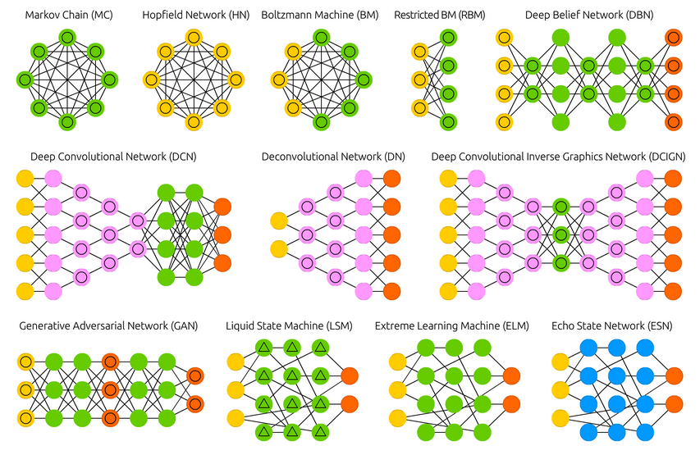
Deep Learning Architectures II

Slide 27
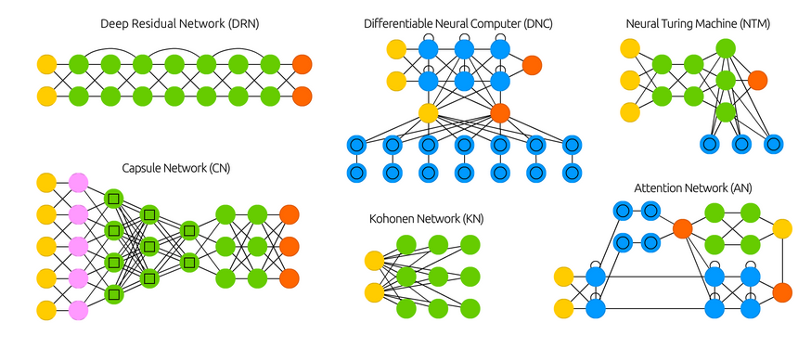
Deep Learning Architectures III

Slide 28
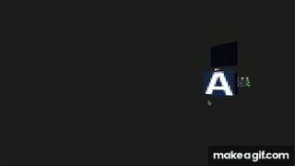
Convolutional Neural Networks

Slide 29
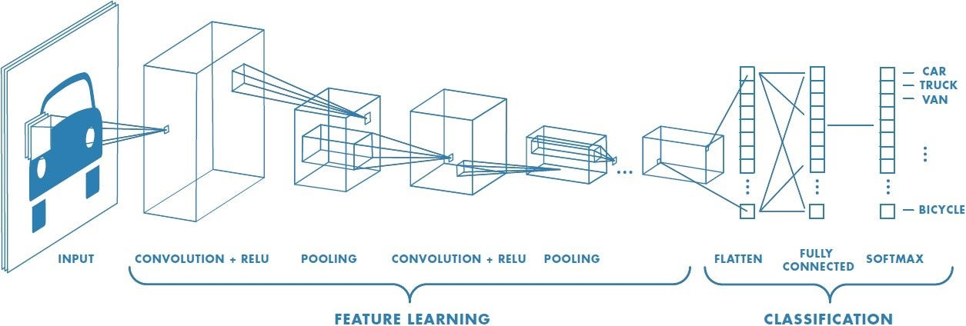
Convolutional Neural Networks

Slide 30
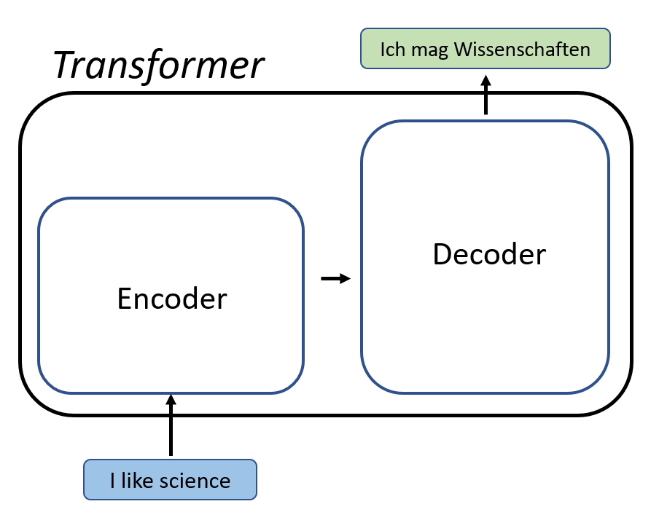
Transformers

Slide 31
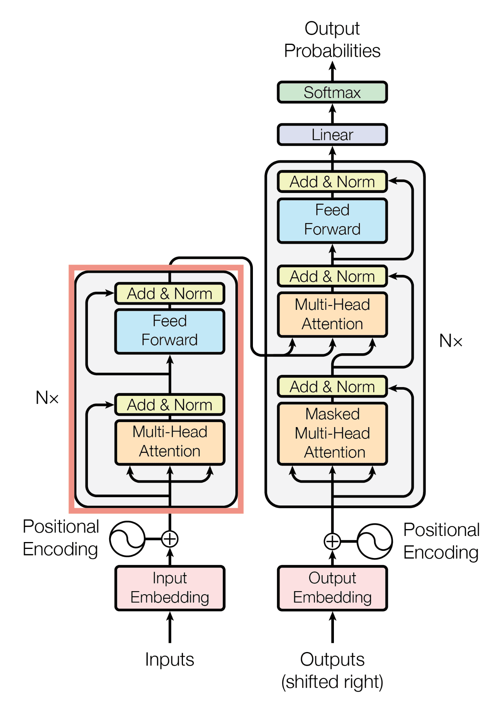
Transformers

Slide 32
Overview
Introduction
Neural Networks
Deep Learning
Image Classification
Time Series
Reinforcement Learning
ML-Agents
References

Slide 33
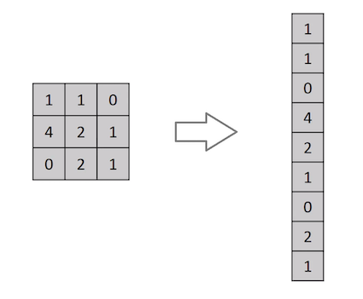
Image processing: issue 1
Multilayer perceptron expects vector (1D) as input
Solution: transform image (2D) to vector (concatenate rows of pixels)
Problem: vertical pixel context lost Example on MNIST:
Example code/source

Slide 34
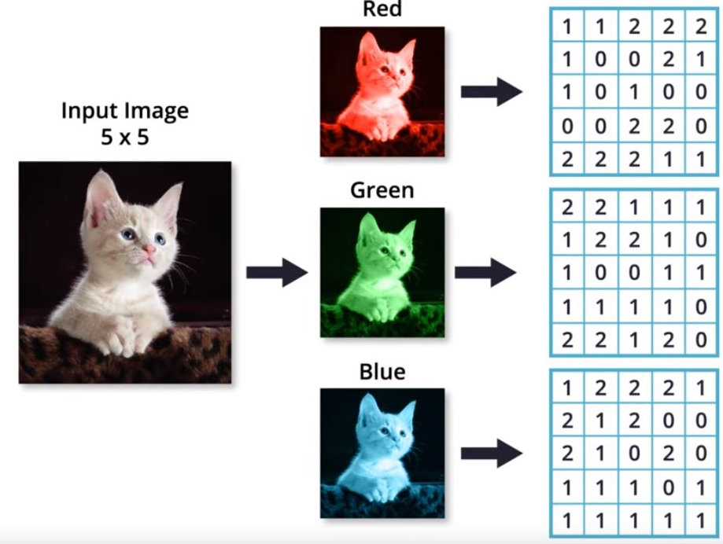
Image processing: issue 2
Colour images are 3D (one 2D matrix of pixels per colour, typically 3: red, green, blue)
Transforming this to vector: channel information on the same pixel is disconnected

Slide 35
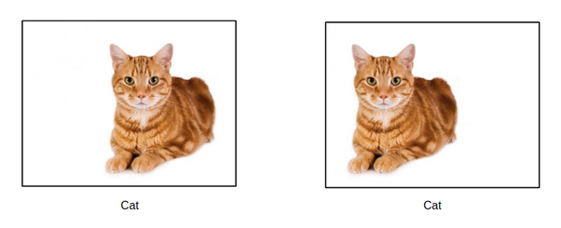
Image processing: issue 3
An object can appear at different locations on images
MLP expect features on fixed positions: don't move!
Image detection should be independent of position on image:
Translation invariance
source

Slide 36
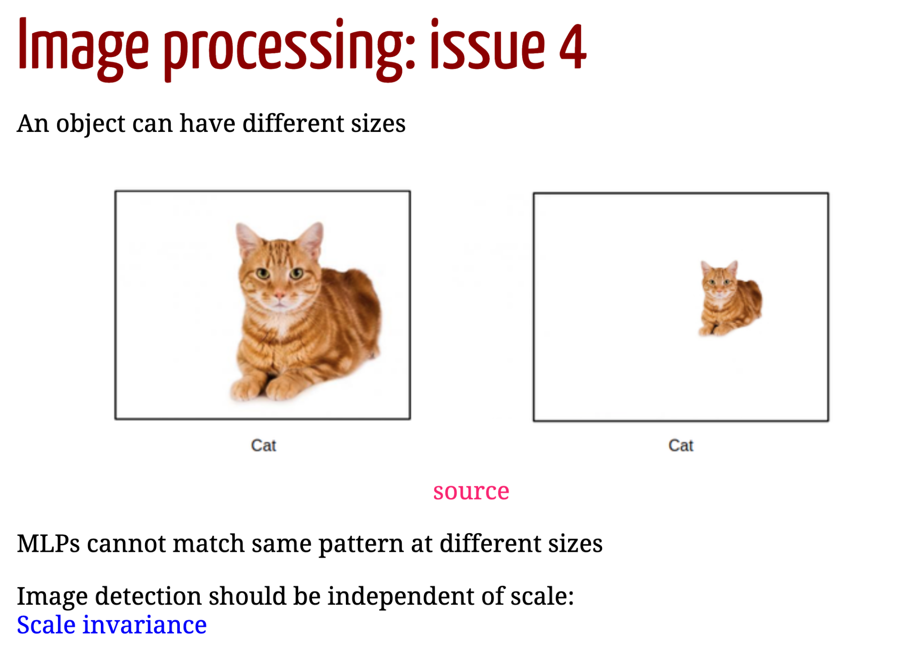
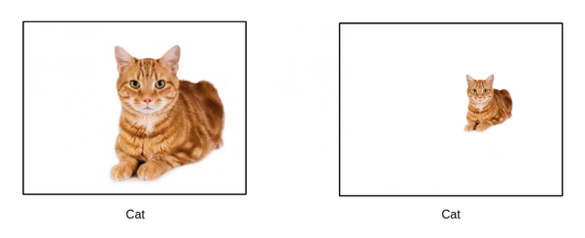
Image processing: issue 4
MLPs cannot match same pattern at different sizes
source
Image detection should be independent of scale: Scale invariance

Slide 37
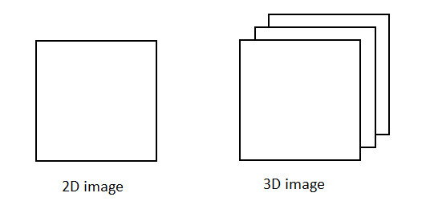
Image processing: solutions
A good image processing NN should:
Admit (and take advantage of!) the 2D/3D structure of the image
Be invariant to translation
Be invariant to scale

Slide 38

Convolutional Neural Networks
for processing image & video:
invariant to translation & scale
computational efficiency
Source: A Comprehensive Guide to Convolutional Neural Networks

Slide 39
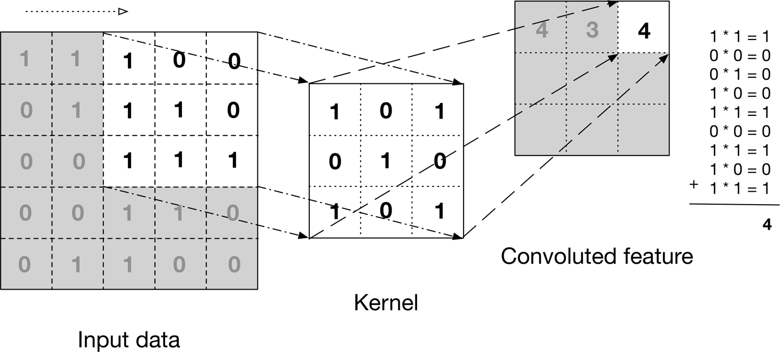
Convolution
Math op. on two functions (f, g) (matrices here) where the result is the transformation of ƒ as it passes through g

Slide 40
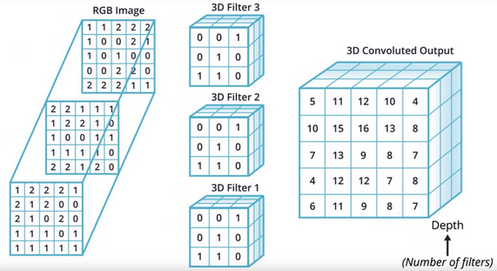
Convolution 3D
source

Slide 41
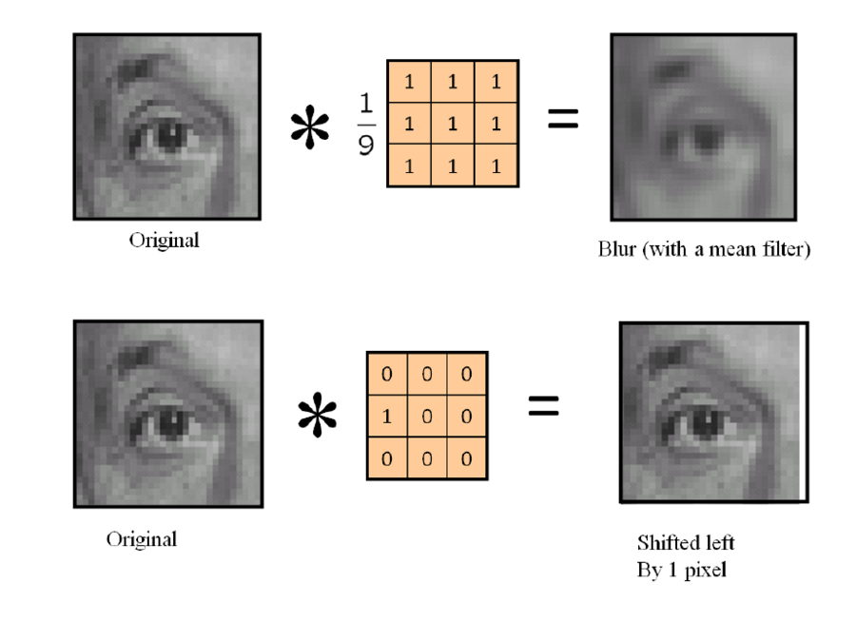
Kernel / Filter Examples
source

Slide 42
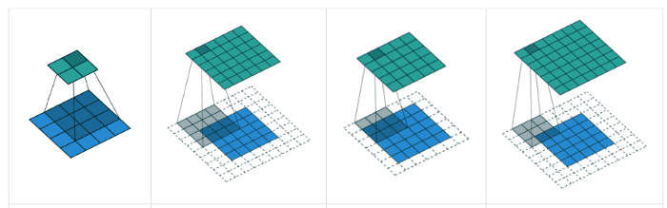
Convolutional Layer
Train several filters (parameter of the layer)
Each filter specializes in one feature (vertical/horizontal lines, corners, circles...)
Kernels / Filters:
Random initialization
Usual size 3x3 or 5x5
Padding (padding='same'): margin (valid, same, full)
Stride (strides=(2, 2)): how much the filter is move at each step
source

Slide 43
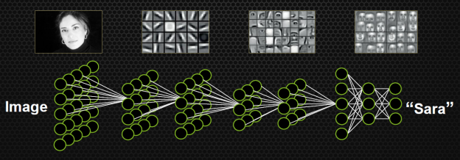
Filter output: feature maps
Result of input image after passing through a convolutional filter
One feature map per filter per image
source

Slide 44
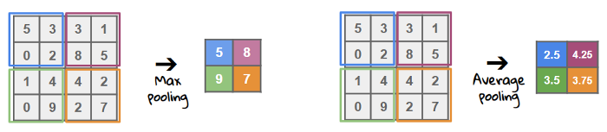
Pooling
Reduce dimensionality for
computational cost (number of units)
dominant features (rotational
and positional invariant)
It does not require training
Operations:
nax (edges)
average (photo)
source

Slide 45
CNNs in Keras on MNIST
Examples:
CNN & MNIST / Source
ImageDataGenerator: batches of image data with real-time data augmentation (it allows to train large data sets of images).
flow_from_directory tutorial
flow_from_dataframe tutorial
Other Image Architectures
Vanilla CNN
VGG
DenseNet
ResNet
...

Slide 46
Overview
Introduction
Neural Networks
Deep Learning
Image Classification
Time Series
Reinforcement Learning
ML-Agents
References

Slide 47
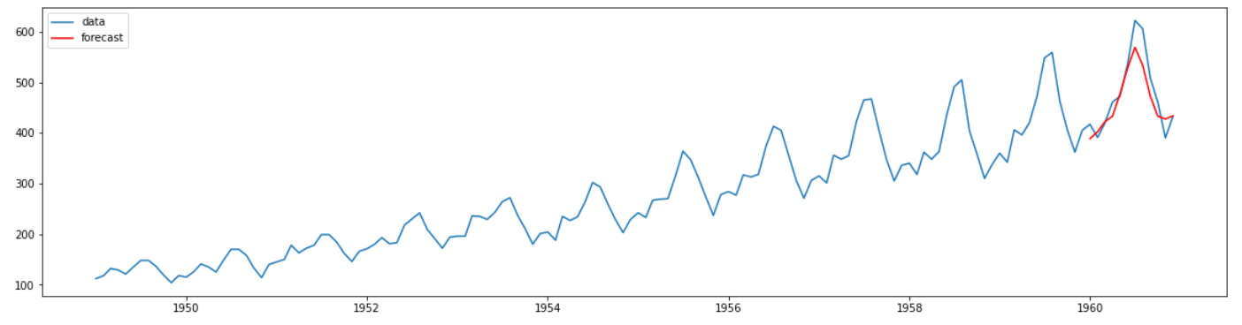
Data with time (sequences)
Temperatures, prices, population
Text, speech
Genomic sequences, atoms in molecules...
Movements (cell phone, sensors, cardio...)
Network packages (intrusion detection)
Samples are not independent (MLPs have no memory!)

Slide 48
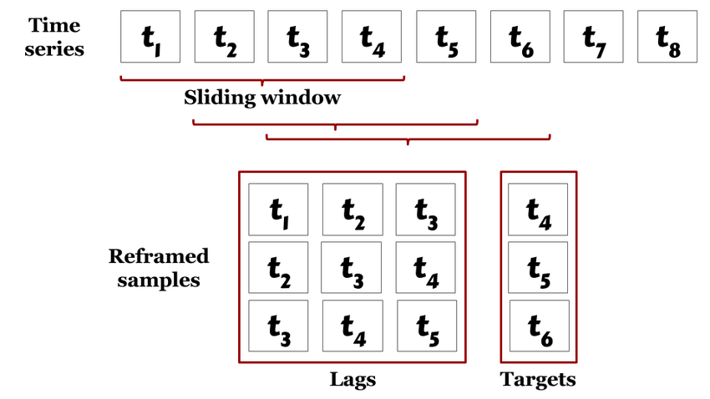
Sliding windows
First approach: pick n samples at once (last n samples)
Pros: you can use standard MLPs
Cons: define window size, prepare the data, complex with vector-sized inputs

Slide 49
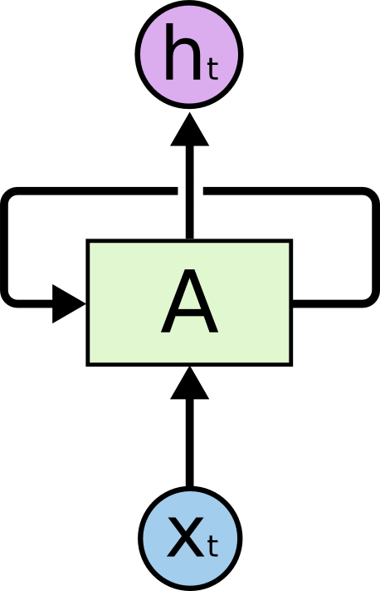
Recurrent Neural Network
Feed previous outputs as additional inputs
RNN have loops source
Problem: vanishing/exploding gradients
source

Slide 50
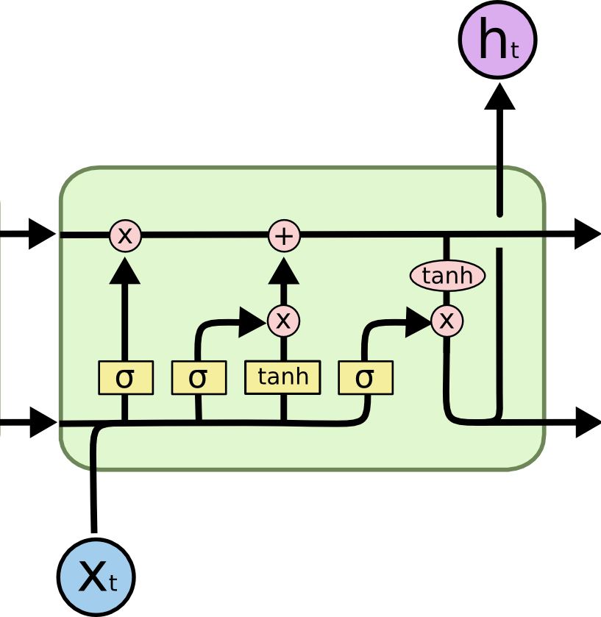
Long Short-Term Memory
Trainable in practice (no vanishing/exploding gradients)
Source: Understanding LSTM Networks

Slide 51
Keras & Time Series
Keras TimeSeries Generator: Utility class for generating batches of temporal data.
Documentation
Keras example on generator & lstm:
Air Passengers data
Code example
Source
Multivariate time series example

Slide 52
Overview
Introduction
Neural Networks
Deep Learning
Reinforcement Learning
Q-learning
Deep Q-learning
ML-Agents
References

Slide 53
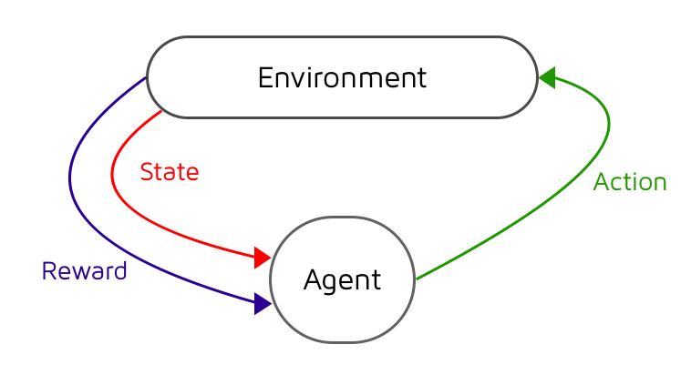
Reinforcement Learning
learn from behaviors rather than data
Loop: state → action → reward
Goal: maximize the expected cumulative reward
Components:
an agent
Action a set of states S
a set of actions A
Rewards R (positive or negative)
Quality: Q: SxA→ R
Policy: π(s)→ a
source

Slide 54
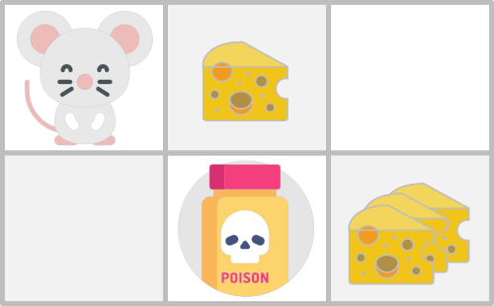
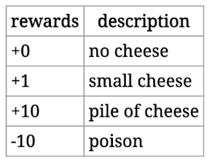
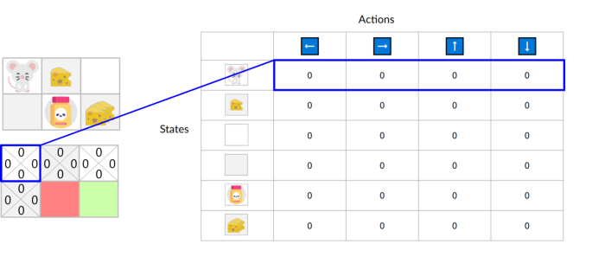
Q-Learning Example

Slide 55



The Bellman equation
Discount:
Update

Slide 56

Q-table example
Training the example
Thomas Simonini. Q-Learning, let’s create an autonomous Taxi, 2020.
Tawsif Kamal. An Intuitive Approach to Q-Learning (P1), 2021.

Slide 57


Exploration vs Exploitation
Source: Q-Learning, let’s create an autonomous Taxi

Slide 58








Open AI Gym
Gym is a toolkit for developing and comparing reinforcement learning algorithms
It contains several environments & documentation
Many programming languages have interfaces to Gym (like python)
Brockman et al. OpenAI Gym, 2016.

Slide 59
FrozenLake
FrozenLake-vo is a toy problem environment.
Laberinth type problem.
State:
Actions:
• Code / source
• OpenAI Gym reference
SFFF (S: starting point, safe)
FHFH (F: frozen surface, safe)
FFFH (H: hole, fall to your doom)
HFFG (G: goal, where the frisbee is located)
LEFT = 0
DOWN = 1
RIGHT = 2
UP = 3

Slide 60

Q-Learning Example
Simple example of Q-learning & Q-Table
Unity Package (in Spanish)
See the folder Scripts in Assets

Slide 61
Overview
Introduction
Neural Networks
Deep Learning
Reinforcement Learning
Q-learning
Deep Q-learning
ML-Agents
References

Slide 62

Q-Learning & Deep Q-Learning
source

Slide 63

Deep Q-Learning
Convolutional Neural Network for learning Q tables
Deep Q-Learning for Atari Breakout
DeepMind. Deep Reinforcement Learning.

Slide 64


CartPole
Cartpole reference
Input: action (0 or 1); training target
Output:
next_state, reward, info; training features
done: game ended? max: 501
It’s a starting point from OpenAi for Deep Reinforcement Learning
Example:
Fast Code
Code with renderized Gym
References:
Rendering OpenAi Gym in Google Colaboratory
Proximal Policy Optimization: policy gradient method
TF-Agents: reinforcement learning in tensorflow
https://gymnasium.farama.org/

Slide 65
Overview
Introduction
Neural Networks
Deep Learning
Reinforcement Learning
ML-Agents
References

Slide 66

ML - Agents
Unity plugin for training intelligent agents
Address: https://github.com/Unity-Technologies/ml-agents
Contain: AI Gym, Deep Learning & Reinforcement Learning (PPO).
Example 2:
Hide and Seek…

Slide 67
Ml- Agents : Documentation
Main page
ML-Agents Toolkit Overview
Example Learning Environments
Installation
Making a New Learning Environment
Getting Started Guide
Training Configuration File
ML-Agents in Unity Learn:
Hummingbirds course by Adam Kelly.

Slide 68

Roller Ball: ML- Agents Tutorial
Behaviour:
roll the ball toward the cube
avoiding falling off the platform
Example video
Source: Making a New Learning Environment

Slide 69

Components of the agent
Basic:
Agent script
Decision Requester
Behavior Parameters
Other:
Ray Perception Sensor 3D
Camera Sensor

Slide 70
Agent Script
using Unity.MLAgents;
using Unity.MLAgents.Sensors;
using Unity.MLAgents.Actuators;
public class RA2 : Agent
{
public override void Initialize()
// Agent Start
public override void OnEpisodeBegin()
// Episode Start
public override void CollectObservations(VectorSensor sensor)
// sensor.AddObservation(item);
public override void OnActionReceived(ActionBuffers actionBuffers)
// Called when and action is received from either
// the player input or the neural network
public override void Heuristic(in ActionBuffers actionsOut)
// Player control instead of neural network
}

Slide 71
Episode Initialization
public override void OnEpisodeBegin()
{
// If the Agent fell, zero its momentum
if (transform.localPosition.y < 0)
{
rBody.angularVelocity = Vector3.zero;
rBody.velocity = Vector3.zero;
transform.localPosition = new Vector3( 0, 0.5f, 0);
}
// Move the target to a new random spot
Target.localPosition = new Vector3(Random.value * 8 - 4,
0.5f,
Random.value * 8 - 4);
}

Slide 72
Environment Observation
public override void CollectObservations(VectorSensor sensor)
{
// Target and Agent positions, size = 3x2
sensor.AddObservation(Target.localPosition);
sensor.AddObservation(transform.localPosition);
// Agent velocity, size = 2
sensor.AddObservation(rBody.velocity.x);
sensor.AddObservation(rBody.velocity.z);
}
ML-Agents built-in sensors should not be included in CollectObservations, such as:
Ray Perception Sensor 3D
Camera Sensor

Slide 73
Tasks & heuristic
Movement
Called from Neural network models or from Heuristic function
public override void OnActionReceived(ActionBuffers actionBuffers)
{
// Actions, size = 2
Vector3 controlSignal = Vector3.zero;
controlSignal.x = actionBuffers.ContinuousActions[0];
controlSignal.z = actionBuffers.ContinuousActions[1];
rBody.AddForce(controlSignal * forceMultiplier);
}
Player (testing)
public override void Heuristic(in ActionBuffers actionsOut)
{
var continuousActionsOut = actionsOut.ContinuousActions;
continuousActionsOut[0] = -Input.GetAxis("Horizontal");
continuousActionsOut[1] = -Input.GetAxis("Vertical");
}

Slide 74
Rewards
public override void OnActionReceived(ActionBuffers actionBuffers)
{
...
// Fell off platform
if (transform.localPosition.y < 0)
{
SetReward(-1.0f);
EndEpisode();
}
}
void OnTriggerEnter(Collider col)
{
// Reached target
if (col.transform.CompareTag("goal"))
{
SetReward(1.0f);
EndEpisode();
}
}
AddReward: increments the reward

Slide 75
Training the Environment
Assets / config /rollerball_config.yaml:
behaviors:
RollerBall:
trainer_type: ppo
hyperparameters:
batch_size: 10
buffer_size: 100
learning_rate: 3.0e-4
...
network_settings:
normalize: false
hidden_units: 128
num_layers: 2
...
max_steps: 500000
summary_freq: 10000
...
Console:
mlagents - learn config/rollerball_config.yaml –run-id=RollerBall

Slide 76


Statistics Monitoring
Console:
tensorboard -- logdir results --port 6886

Slide 77
Training Methods
ML-Agents Toolkit Overview:
Deep Reinforcement Learning
Recurrent Neural Networks
Convolutional Neural Networks
Behavioral Cloning
Training Multi-Agents
Curiosity Learning
...
Configuration File (yaml)

Slide 78
Overview
Introduction
Neural Networks
Deep Learning
Reinforcement Learning
ML-Agents
References

Slide 79
References
Aurélien Géron. Hands-On Machine Learning with Scikit-Learn, Keras & Tensorflow, 2nd Edition. O'Reilly, 2019.
Keras code examples.
DeepMind. Deep Reinforcement Learning.
Micheal Lanham. Hands-On Deep Learning for Games. Packt, 2019.
Micheal Lanham. Hands-On Reinforcement Learning for Games. Packt, 2020.

Slide 80
Videos
Károly Zsolnai-Fehér. OpenAI Plays Hide and Seek…and Breaks The Game!. Two Minute Papers.
Károly Zsolnai-Fehér. DeepMind’s AlphaStar: A Grandmaster Level StarCraft 2 AI. Two Minute Papers.
Siraj Raval. How to Make an Amazing Video Game Bot Easily (OpenAI Gym), 2016.
Adam Kelly. ML-Agents: Hummingbirds. Unity Learn.
Documentation
Keras Documentation
Barracuda
ONNX
OpenAI Gym
ML-Agents

